Slide 1

Securing Data with Blockchain and AI
A Capstone Project Exploring Secure and Transparent Data Sharing
Team Members:
Hari Varma Nagaraju (Y00869461)
Tarun Kumar Reddy Mulagani (Y00870434)
Naveen Maddula (Y00869131)
Guidance
Dr. Robert A Gilliland

Slide 2
Introduction to SecNet
Overview:
SecNet is a secure data-sharing framework tailored for the healthcare sector.
Combines Blockchain Technology and Artificial Intelligence (AI) for robust security.
Key Features:
Ensures data privacy and ownership control for patients.
Provides a permission-based system for secure data sharing with hospitals.
Significance:
Addresses critical challenges of data security in modern healthcare systems.
Promotes trust and collaboration among stakeholders.

Slide 3

Background
Problems in existing data systems:
Users lose control of their data once shared.
Data ownership is not guaranteed.
Threats of data misuse and lack of transparency.
Current solutions are inadequate for secure data sharing in trustless environments.

Slide 4

Problem Statement
Major challenges:
Ensuring data privacy and ownership in a decentralized system.
Providing a transparent mechanism for data sharing in trustless environments.
Enabling AI to access high-quality data without compromising security.
Why this matters:
Big data misuse by corporations.
Lack of real-time monitoring for data transparency.

Slide 5
Core Components of SecNet Methodology
Blockchain-Based Data Sharing:
Ensures tamper-proof storage and validates data ownership.
Patients have complete control over data-sharing permissions.
AI-Based Secure Computing:
AI dynamically generates and enforces security rules.
Enhances data protection with intelligent safeguards.
Economic Incentives:
Implements smart contracts to reward data sharing.
Encourages collaboration between patients and hospitals.
Personal Data Centers (PDCs):
Decentralized, user-controlled systems for secure data storage.
Patients manage and monitor their data independently.

Slide 6
Modular Structure of the Framework
Module 1: Patients:
Patients create a profile with disease details and choose hospitals to share data with.
Blockchain objects define allowable permissions for hospitals.
Patients can log in to track rewards earned through data sharing.
Module 2: Hospitals:
Hospitals (e.g., Hospital1, Hospital2) access patient data upon permission.
Hospitals search by disease names, and AI identifies matching patient records.
Only patients who have granted permission are displayed.
Key Integration:
AI performs searches and verifies permissions using blockchain rules.
Ensures secure and efficient data-sharing workflows.

Slide 7
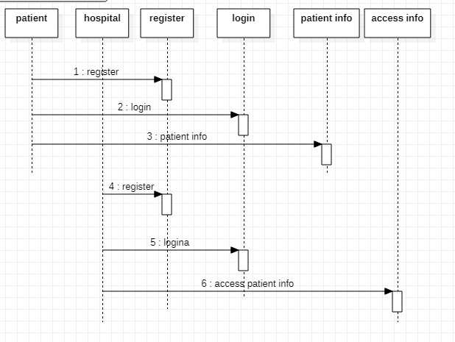
FLOW CHART

Slide 8
Experiments
Experiment Goals:
Simulate data-sharing scenarios using blockchain.
Validate data ownership and secure transactions.
Implementation:
Use blockchain to record data-sharing logs.
Deploy AI algorithms to detect patterns and potential misuse.
Performance Evaluation:
Test for scalability in environments with multiple data providers.

Slide 9

Discussion
Advantages of SecNet:
Transparency: Blockchain provides immutable records of data usage.
Data Ownership: Users retain full control of their shared data.
AI Enhancement: Access to trusted, high-quality data.
Challenges:
High resource demand for blockchain systems.
Scaling blockchain for large datasets.
Complexities in integrating blockchain with real-time AI analytics.
Applications:
Privacy-preserving systems for healthcare, finance, and IoT networks.

Slide 10
Conclusion
Summary:
SecNet integrates blockchain and AI for secure data sharing and threat mitigation.
Combines tamper-proof blockchain with AI-driven security rules.
Future Work:
Implementing advanced smart contracts for access control.
Testing on platforms like Ethereum and IPFS.
Impact:
A scalable, secure framework for data sharing in decentralized environments.

Slide 11
Contribution of Team Members
Tarun Kumar Reddy (Research):
Literature review and methodology design.
Hari Varma (Development & Testing):
Implementation of blockchain and AI modules.
Simulation of scenarios and validation.
Naveen (Documentation):
Writing reports and preparing presentation.

Slide 12

Thank you

